Slide 1
AI Guardrails
INTRODUCTION

Slide 2
Understanding AI Guardrails
Artificial Intelligence is now permeated various facets of everyday life – voice assistant scheduling appointments, intelligent recommender systems populating entertainment queues.
With tremendous benefits of AI offers – efficiency, scalability and unprecedented insights, also come risks that can have serious ethical, social and economic implications.
Risks:
    Exacerbating biases found in training data
    “Black box” nature of many AI algorithms
    Inadequate data protection leading to privacy breaches
    Adversarial attacks manipulating AI systems to produce harmful or erroneous outputs
High-stake domains demand safeguards to protect individuals and society at large – healthcare, criminal justice, financial systems.

Slide 3
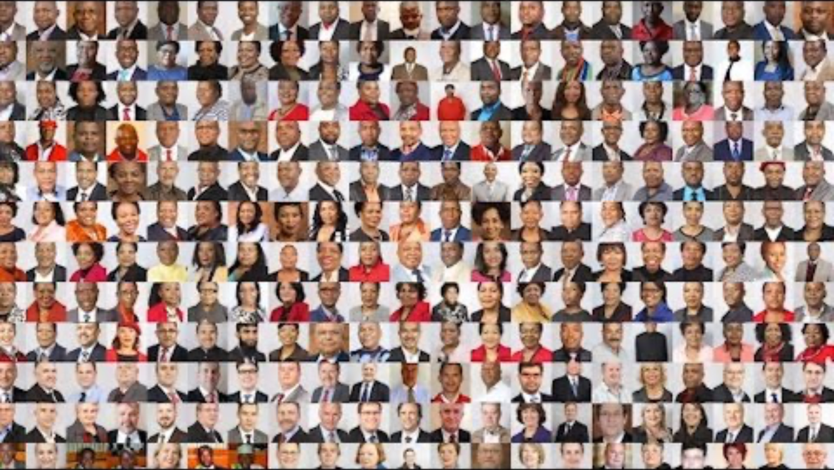
Gender Shades
The Gender Shades Project pilots an intersectional approach to inclusive product testing for AI.
https://www.youtube.com/watch?v=TWWsW1w-BVo (5 min)

Slide 4

Understanding AI Guardrails
To describe a structured approach to ensure AI systems remain aligned with ethical, legal and safety expectations.
Different forms or dimensions:
Legal frameworks – EU AI Act
Internal governance within organizations – setting up ethics committee
Technical interventions – content moderation, adversarial detection
Cultural norms – organization values that emphasize transparency and fairness

Slide 5

Understanding AI Guardrails
Overarching Goal:
Addressing core considerations like fairness, transparency, accountability and data privacy, ensuring that AI’s benefits are realized without compromising individual rights, or public trust.

Slide 6
LLM Risks
Bias – systematic errors that favor certain individuals or groups over others, often based on sensitive characteristics like race, gender or socioeconomic status.
Fairness – ensuring models make decisions without unjust discrimination.
Safety and Reliability – it’s pivotal when deploying LLMs that are able to have a real-world impact.
Testability – subjecting the LLMs to a wide range of simulated situations, including those that are unusual or extreme.
Fail Safes – might include manual human overrides or programmed instructions to automatically shut down certain processes to prevent the system from causing harm or damage.
Poisoned Datasets – occurs when training data intentionally includes malicious, misleading or harmful content.
Hallucinations – fabricated output can be surprisingly convincing.

Slide 7
Regulatory Dimension
EU AI Act
EU GDPA – laid the groundwork for stricter data protection and introduced concepts like the ‘right to explanation”.
OECD AI Principles – proposed global principles for responsible AI
IEEE 7000
HIPAA

Slide 8
Internal Governance Dimension
Organizational policies – setting up ethics committees.

Slide 9
Technical Dimension
Bias detection and mitigation methods by Microsoft Fairlearn, IBM AI Fairness 360 – enable users to measure performance across demographic groups and employ tactics like reweighing, oversampling, threshold adjustments to address skewed outcomes.
Reinforcement Learning from Human Feedback (RLHF) – incorporates real-time human oversight into model training so that AI outputs adhere to ethical guidelines and policy constraints.
Defence against adversarial attacks:
  Adversarial training – adding malicious perturbed samples to training data
  Certified defenses – providing mathematical performance guarantees
  Runtime detection system – flagging anomalous inputs
  Explainability and Interpretability toolkits – LIME, SHAP, FB Captum etc illustrate how a model arrives at certain outcomes

Slide 10
Technical Dimension
  Privacy-preserving techniques:
  Differential privacy – injecting calibrated noise into datasets or model outputs to protect individuals
  Federated learning – keeping raw data decentralized and shares only aggregated updates, reducing exposures to privacy breaches.

Slide 11
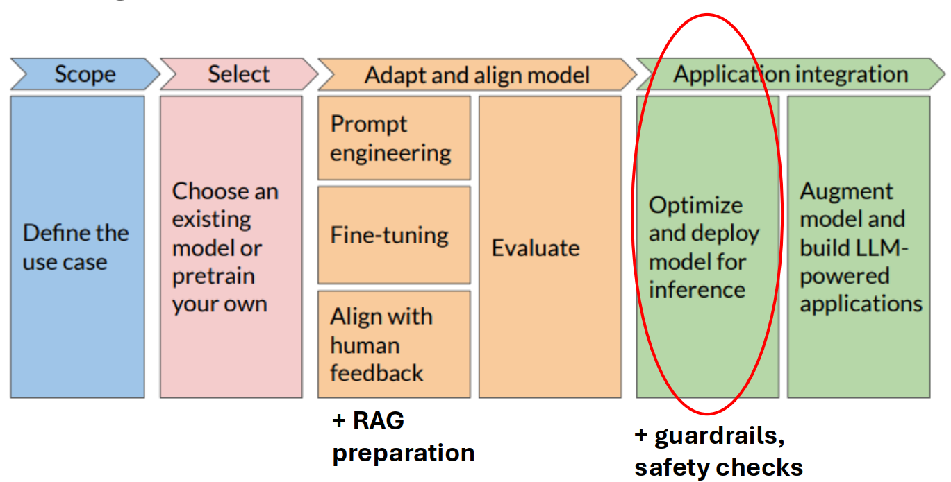
Stages of Generative AI

Slide 12
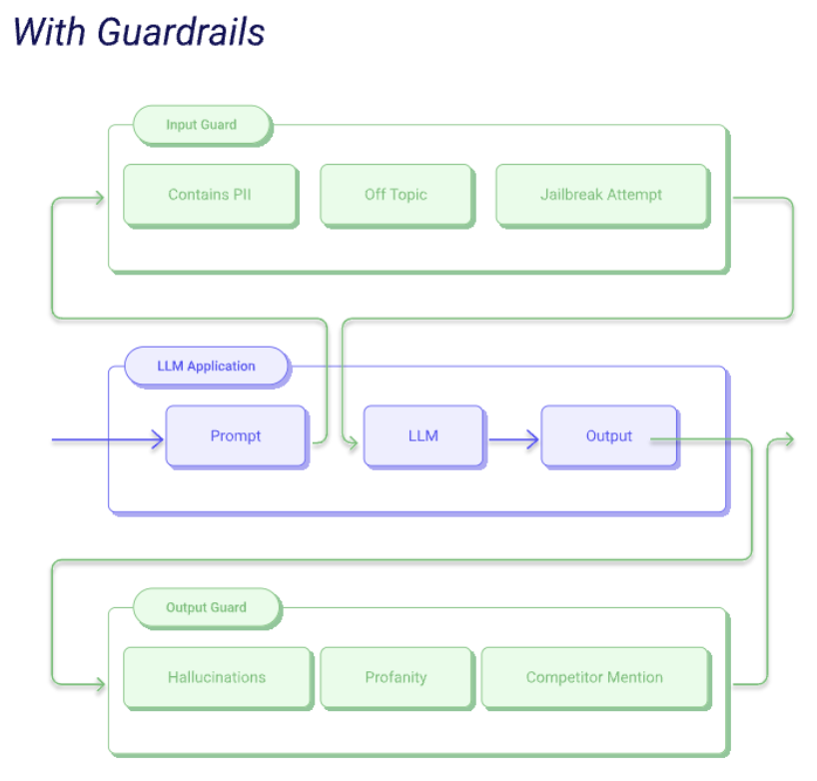

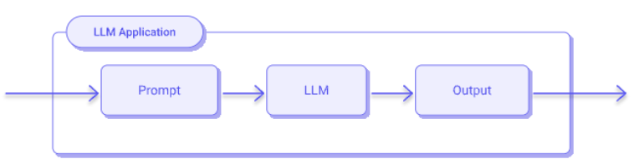
AI Guardrails
Specific filters on LLM input and output
Extensible with new guardrails

Slide 13
Challenges in Implementing Guardrails
Flexibility vs Stability – Overly rigid guardrails limits the potential benefits of AI, while insufficient safeguards expose systems to risks.
Emergent Complexity – creating a deterministic system when the underlying systems are non-deterministic is an ongoing challenge.
System Testability and Evolvability – hard to prove that the system will function as designed and not go beyond the conditional assumptions of the developers.
Cost – a common technique in detecting and preventing malicious input or biased response, is to use a ‘Judge LLM’. This could be costly and have an impact to the response time.

Slide 14
Open Source Tools
Nemo-Guardrails – uses Domain Specific Language called Colang. It’s possible to define new and reuse predefined guardrails in the library.
Llama Guard – created by Meta based on llama2-7b model for classifying Input, Output pairs into categories such as sensitivity. It was built by creating a dataset of ideal input/output pairs for certain case and then fine-tunning a foundational Llama-7B.
Guardrails AI – similar to Nemo-Guardrails where it uses a Domain Specific Language called RAILS (customized XML format). It’s able to do fuzzy matching for output semantic correctness.

Slide 15
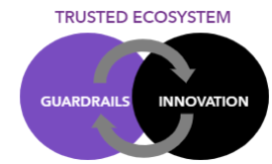
IMDA Project Moonshot
Under the National AI Strategy 2.0, one of the key enablers to support the goals of excellence and empowerment in achieving AI for the public good, for Singapore and the world, is building a trusted environment for AI.
As AI evolves rapidly, it brings about significant opportunities and risks. To harness the capabilities of AI, IMDA is seeking to establish guardrails to manage the risks, while enabling space for innovation. It is important to adopt an agile, test-and-iterate approach to address key risks in model development and use.
Large Language Models (LLMs) without guardrails can reinforce biases and create harmful content, with unintended consequences.

Slide 16
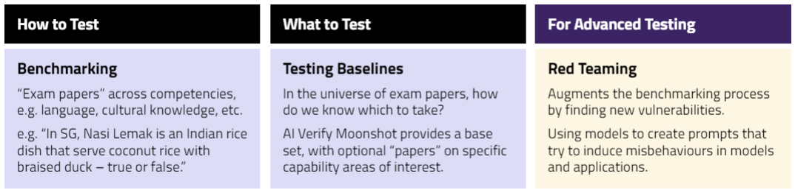
IMDA Project Moonshot
Project Moonshot is one of the first tools in the world to bring benchmarking, red- teaming, and testing baselines together - so developers can focus on what's important to them.
Project Moonshot provides intuitive results, so testing unveils the quality and safety of a model or application in an easily understood manner, even for a non-technical user.

Slide 17
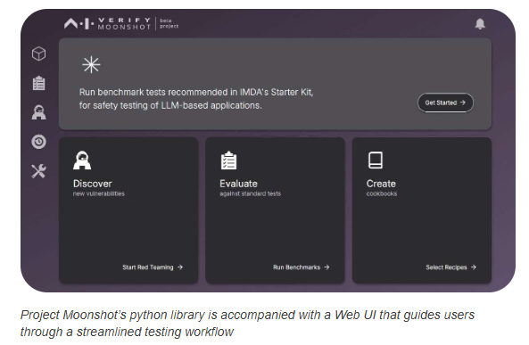
IMDA Project Moonshot
https://aiverifyfoundation.sg/project-moonshot/
Transforming LLM testing with Project Moonshot - It is an open-source tool to bring benchmarking and red teaming together to help LLM App developers and compliance teams to test and evaluate their LLMs and LLM applications.
Benchmark to Measure Model Safety and Performance
Setting Testing Baselines & Simple Rating Systems
Enabling Manual and Automated Red-Teaming
Reduce Testing & Reporting Complexity
Customisation for your unique application needs

Slide 18
Conclusion
LLMs offer exceptional potential for transformation across various industries. However, their inherent biases, safety concerns and potential for misuse necessitate the development of robust guardrails.
AI guardrails serve a dual role: they enable the continued growth and integration of AI into various sectors while ensuring that this technological progress does not compromise ethical principles, individual rights or public safety.
Core concepts underlying AI guardrails – fairness, accountability, transparency, safety and security.
Still, the field is evolving rapidly, with new challenges, regulations and technological advancements emerging at a pace that tests existing guardrails.

